Slide 1

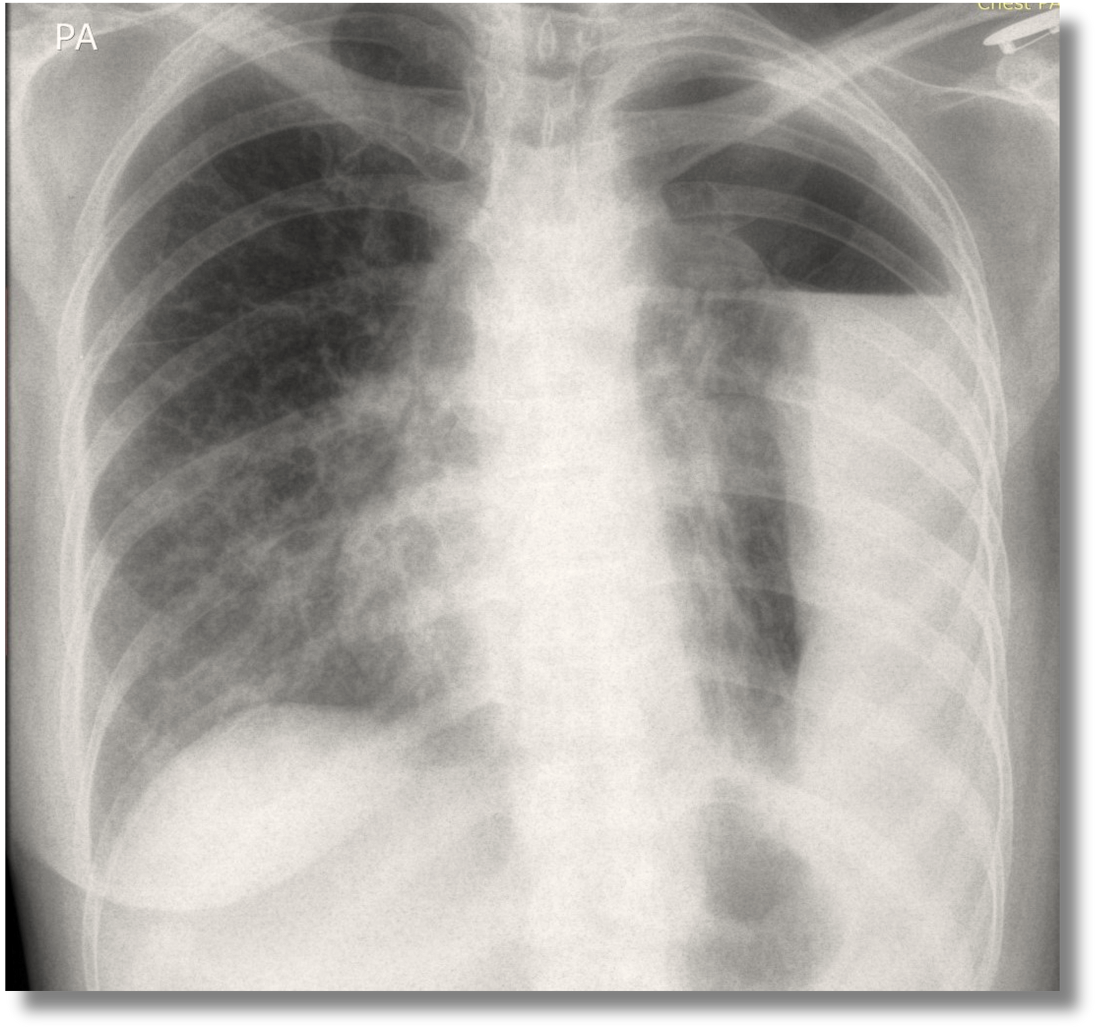
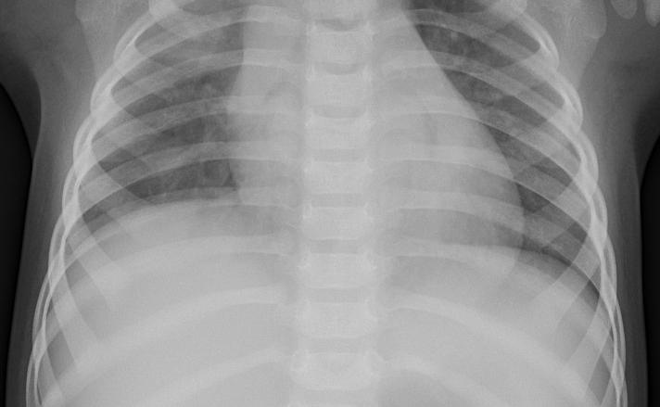
Pneumonia Detection Using CNN and DIP
Leveraging Advanced Imaging Techniques for Healthcare
Muneeb Ahmad
Rayan Lakhani

Slide 2

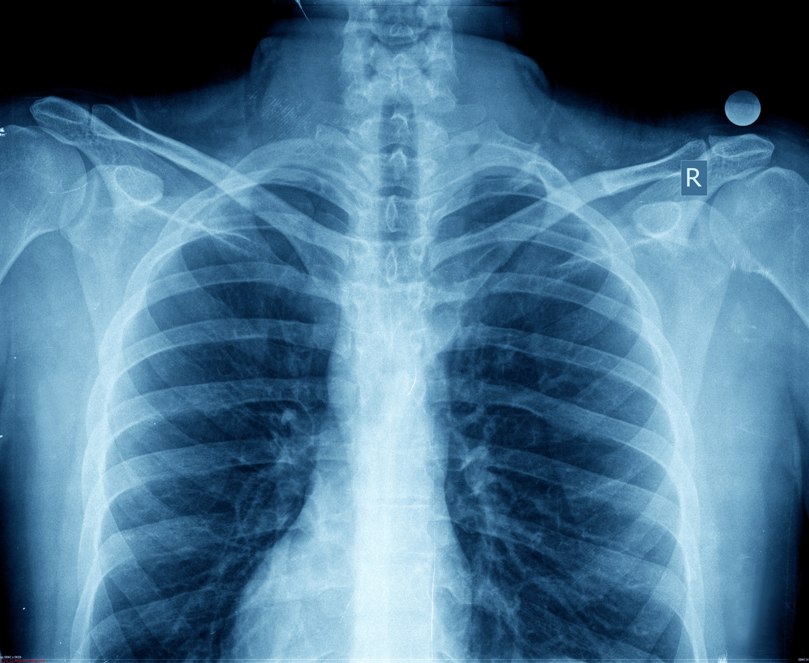
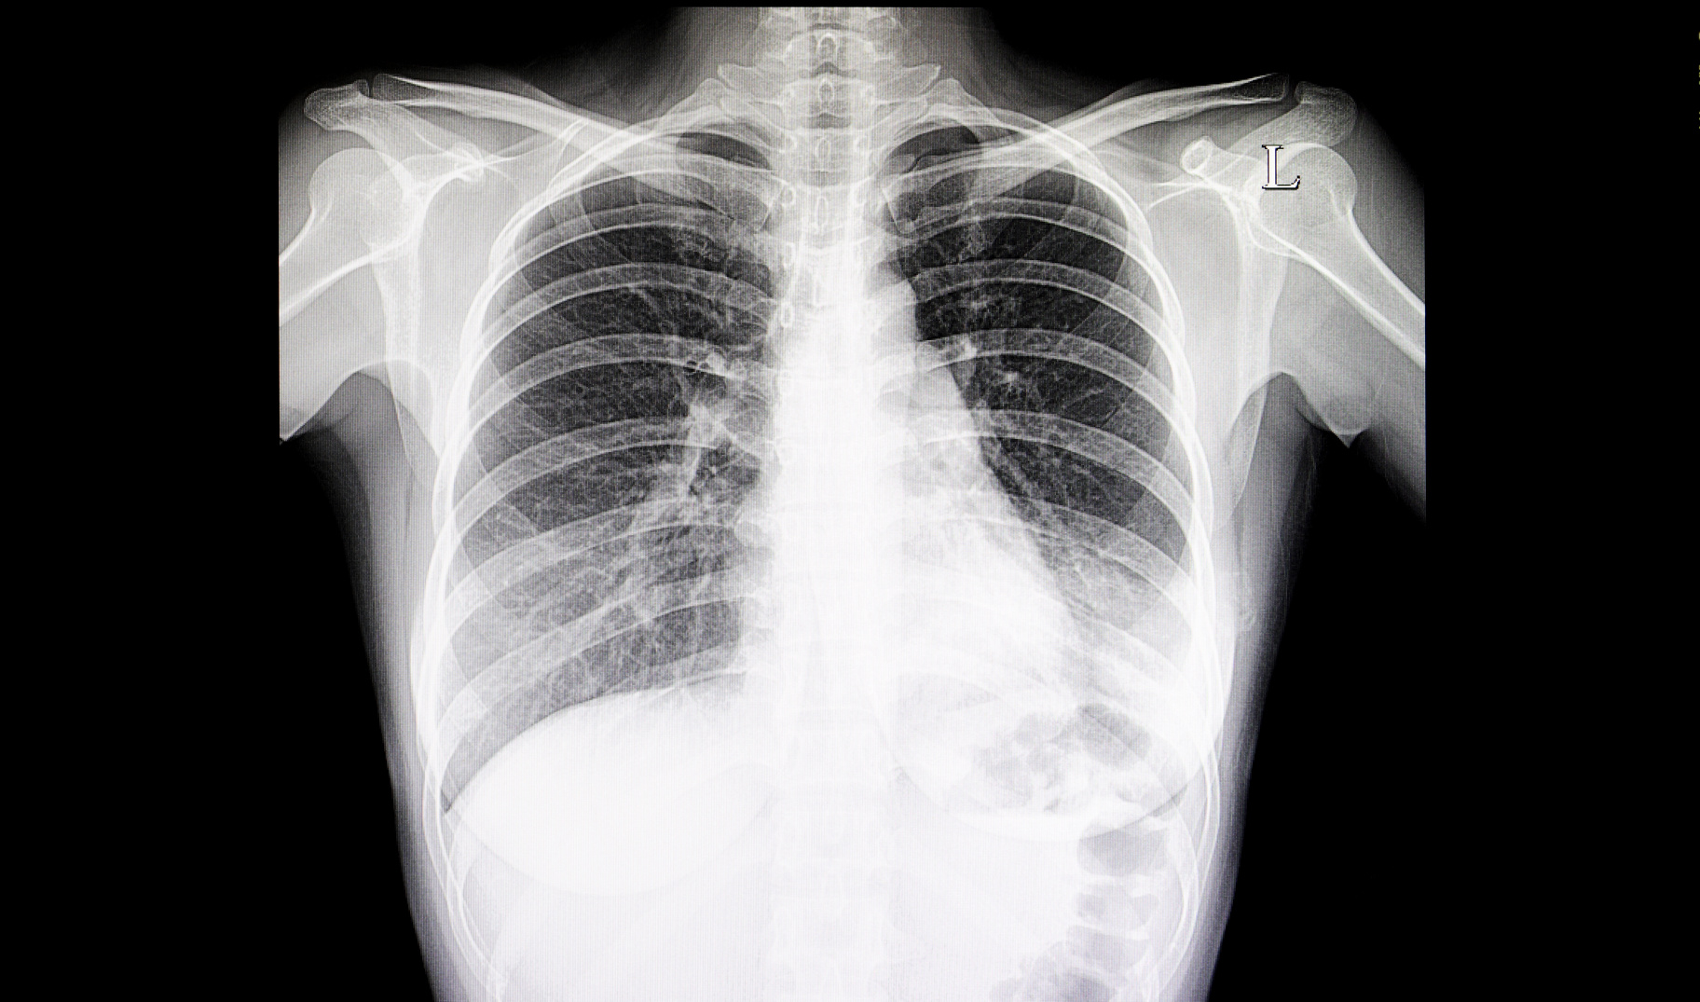
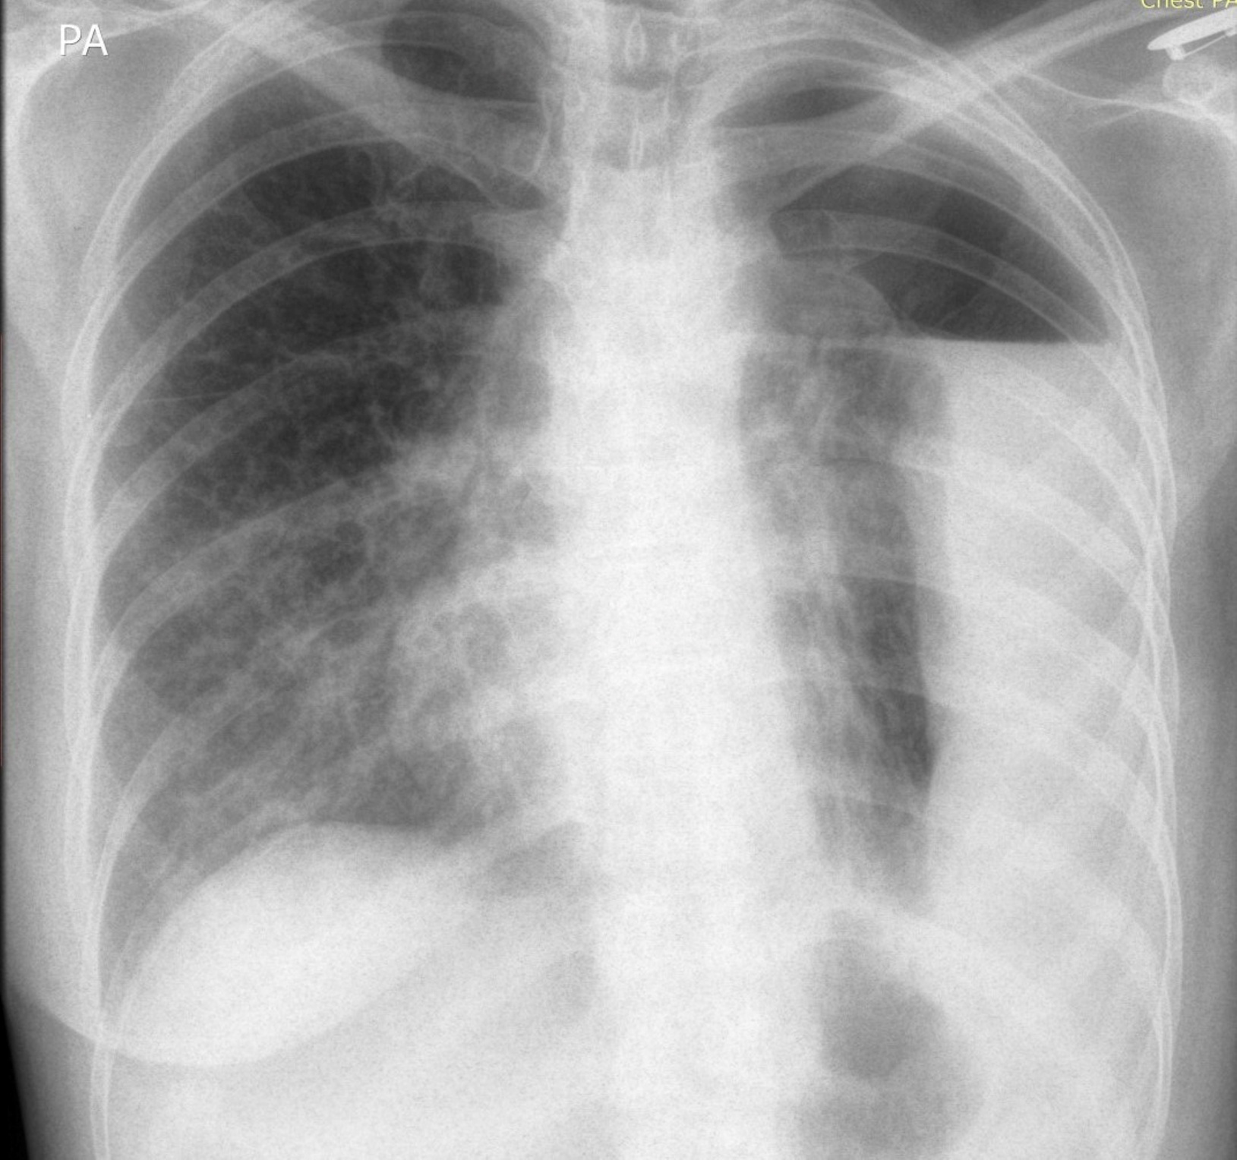
Understanding Pneumonia
Pneumonia is a lung infection that inflames the air sacs in one or both lungs. It can range from mild to life-threatening, with symptoms like coughing, fever, and difficulty breathing. Early and accurate detection is critical for effective treatment.
Cough, which may produce greenish.
Shortness of breath.
Rapid, shallow breathing.
Sharp or stabbing chest pain that gets worse when you breathe deeply or cough.

Slide 3
Enhancement and Analysis:
DIP improves the quality of medical images, including chest X-rays, by enhancing the visibility of critical features for detailed analysis.
01
Digital Image Processing in Medical Diagnostics
DIP improves image accuracy and detail, aiding in reliable diagnosis, particularly for complicated cases such as pneumonia.
Facilitating Accurate Diagnosis
02
DIP techniques optimize medical images for machine learning models like CNNs, improving their accuracy and effectiveness in subsequent analysis.
Integration with Machine Learning:
03

Slide 4
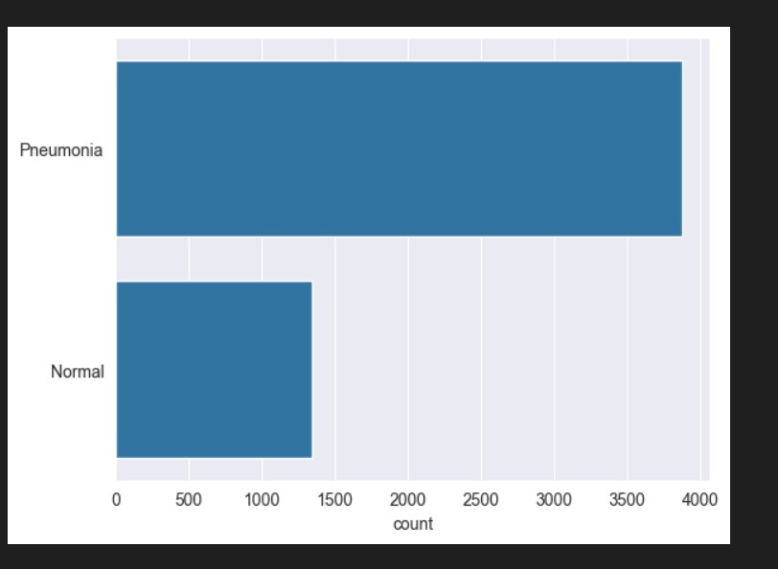
DATASET
Description
Our dataset consists of 5,863 pediatric chest X-ray images, categorized as 'Pneumonia' and 'Normal'. These images are pre-screened for quality and confirmed by medical experts, ensuring reliable data for model training.

Slide 5
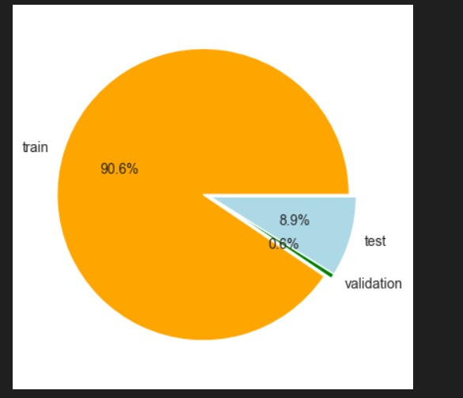
DATASET
Description
We have 90.6% of training images, 8.9% of test images and only 0.6% of validation images.
That’s why we need to do data augmentation

Slide 6
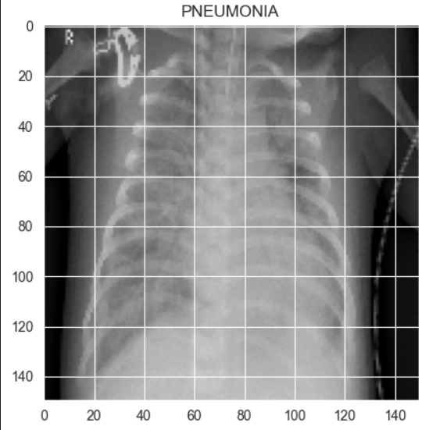
Preparing Images for the Model
The raw X-ray images undergo several preprocessing steps:
1. Grayscale conversion to reduce complexity
2. Resizing to standard dimensions (150x150) for uniformity
3. Normalization to scale pixel values, making the model training more efficient and stable.

Slide 7
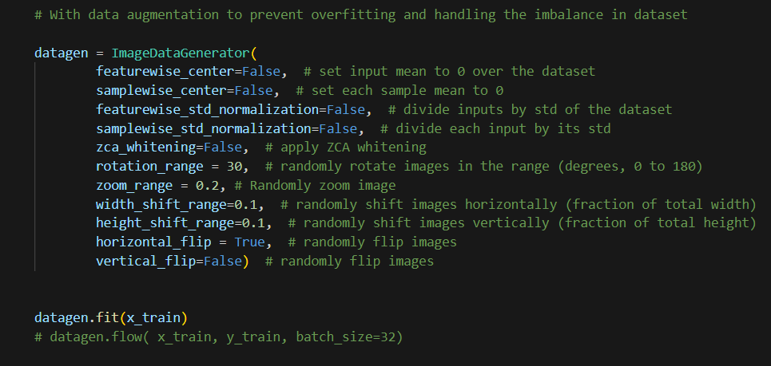
Enhancing the Dataset with Augmentation
To address data imbalance and improve model generalization, we employ data augmentation techniques like rotation, zooming, and flipping. This enriches our dataset, providing a more robust training environment for the CNN.

Slide 8
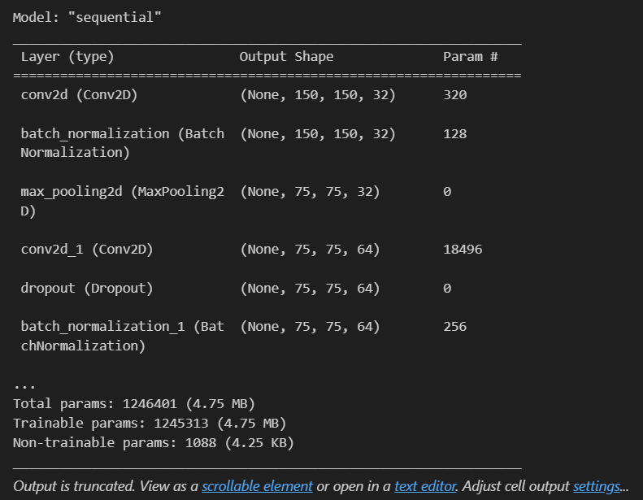
Designing the CNN Model
Our CNN architecture comprises convolutional layers for feature extraction, pooling layers for dimensionality reduction, and dense layers for classification. Each layer's purpose is to progressively abstract and identify pneumonia indicators in X-ray images.

Slide 9
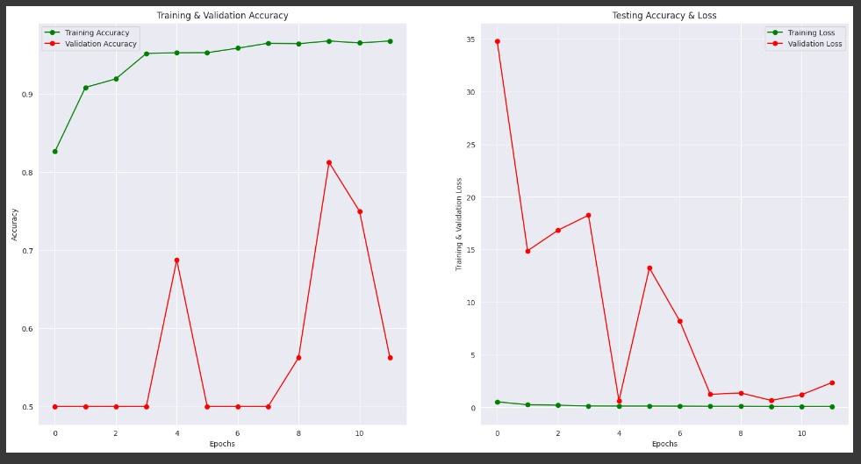

Training and validation accuracy vs loss
No stopping criteria

Slide 10
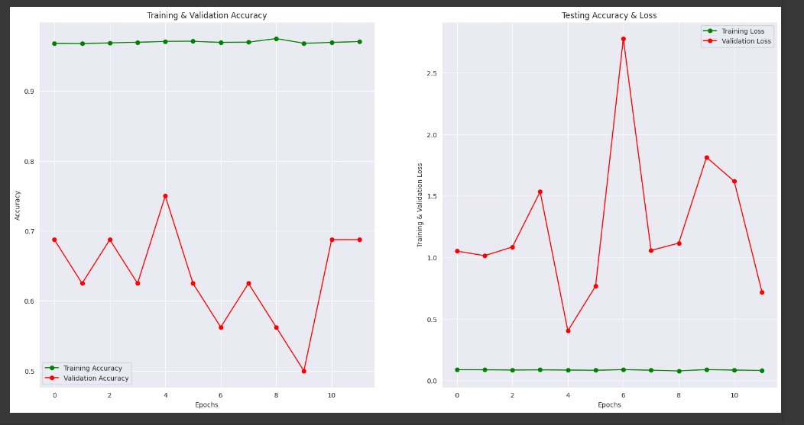
Training and validation accuracy vs loss
EarlyStopping
patience=3
monitor=”val-accuracy”
mode=max
verbose=2

Slide 11
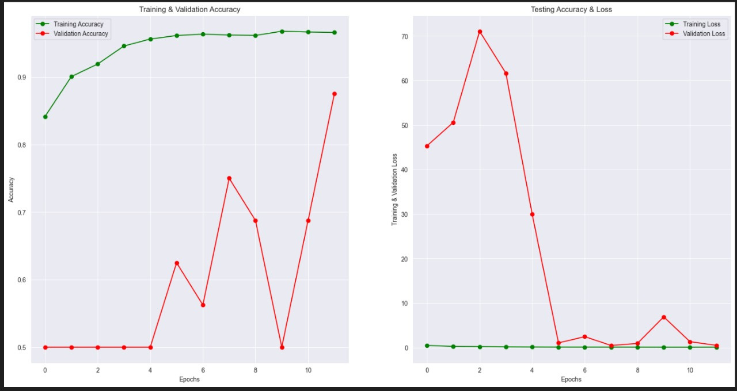
Training and validation accuracy vs loss
ReduceLROnPlateau
monitor='val_accuracy' patience = 2
verbose=1
factor=0.3
min_lr=0.000001

Slide 12
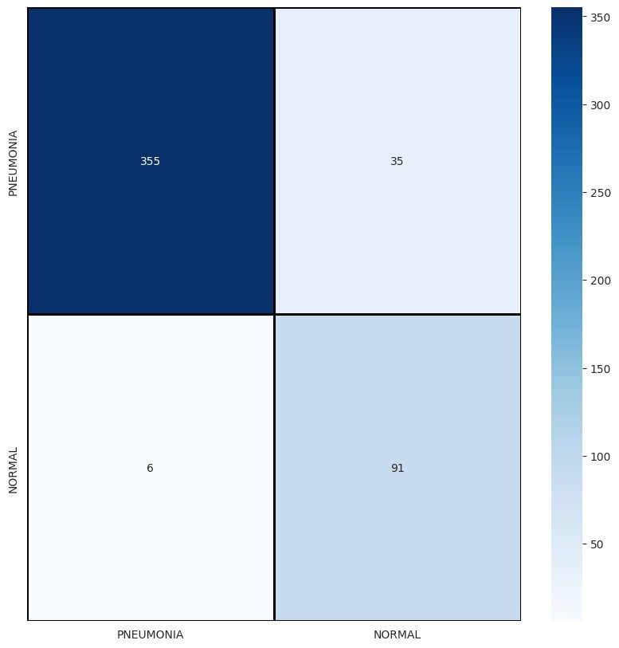
HEAT MAP
EarlyStopping
with “ADAMS” optimizer

Slide 13
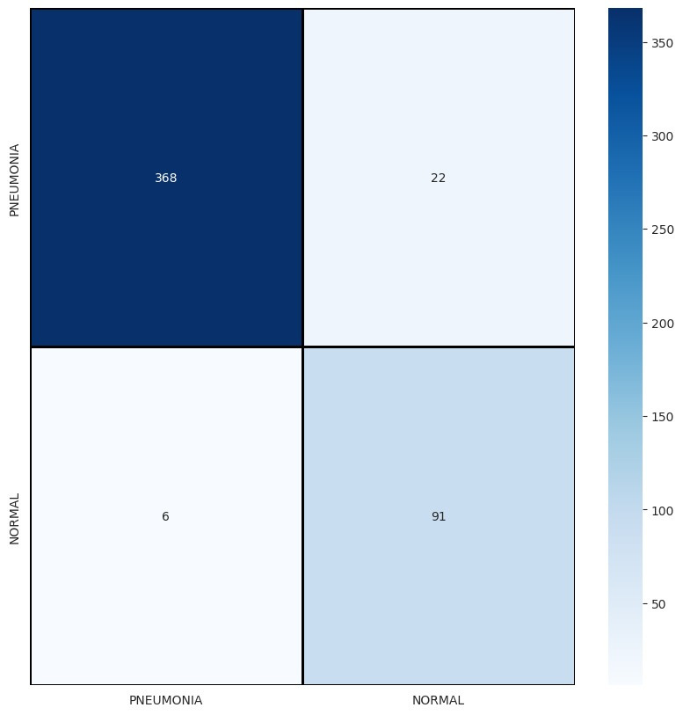
HEAT MAP
ReduceLROnPlateau
with “rmsprop” optimizer

Slide 14
Overcoming Obstacles and Looking Ahead
Challenges:
Imbalanced Dataset
Overfitting issues due to improper stopping criteria and optimization algorithm
Deciding model structure
Training Model after each change.
Future work involves expanding the dataset, incorporating diverse age groups and other diseases like Covid, and exploring 3D imaging for comprehensive analysis.

Slide 15
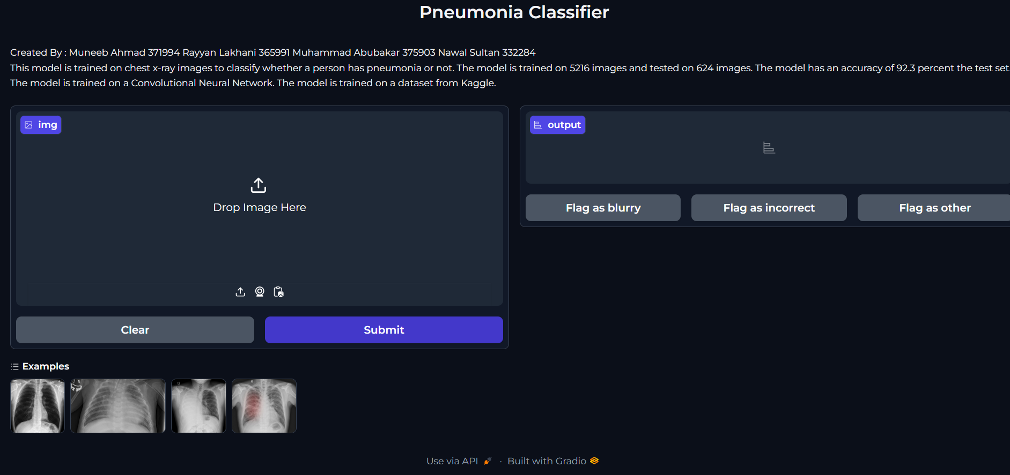
Frontend Built with Gradio

Slide 16
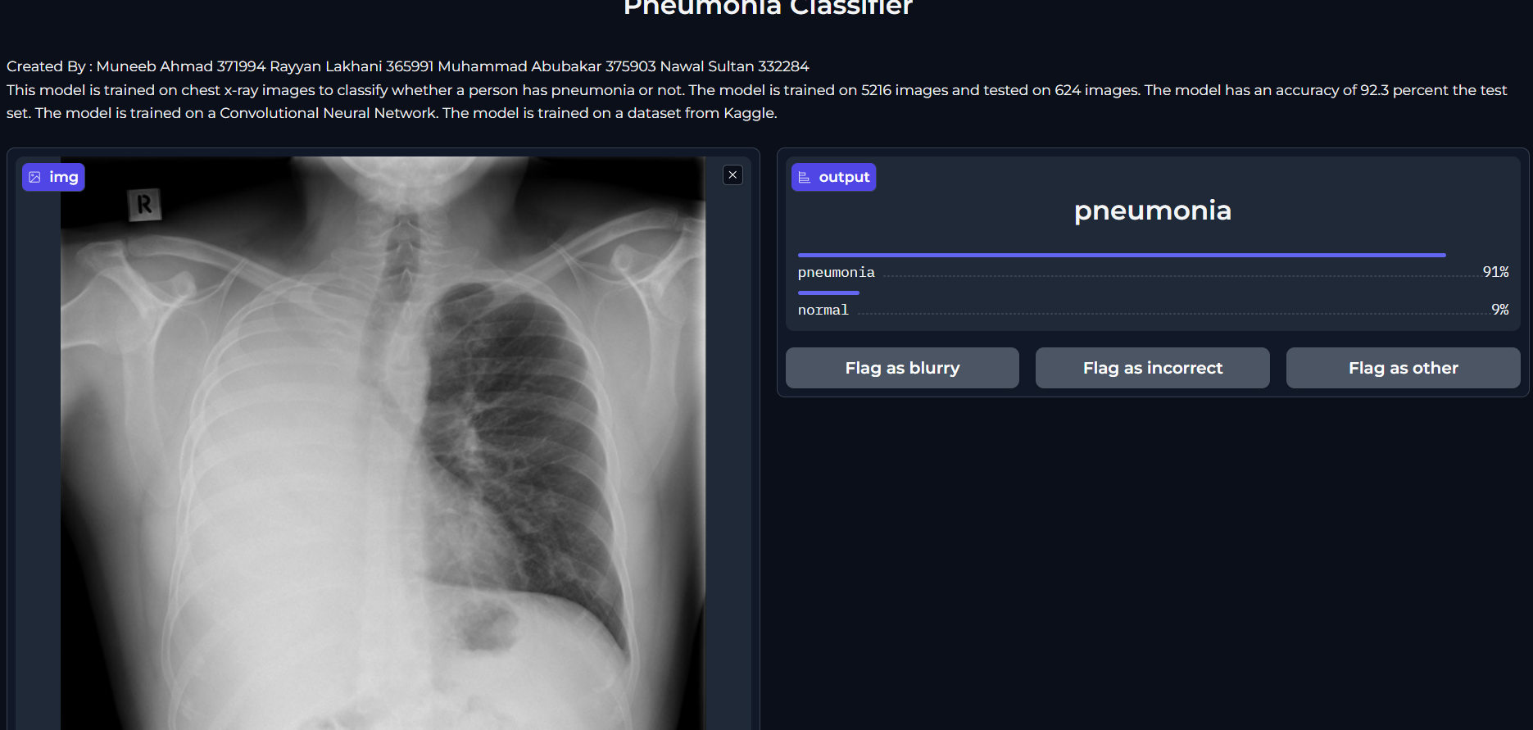
DEMO

Slide 17
THANKS
ANY QUESTIONS?
MUNEEB AHMAD
RAYYAN LAKHANI

